Slide 1
Binary Search + Problem Solving
Srivaths P

Slide 2
Goal:
To learn about prefix sums
To learn the concept of binary search
To learn when binary search can be applied
Problem Solving

Slide 3
Prefix Sums
A prefix sum stores the sum of the prefix of an array at each index. Takes O(N) time complexity to compute.
Prefix sums can be used to answer queries such as “Sum of elements of array from [L, R]” in O(1) time complexity
prefix[k] = sum of array from 0 to k

Slide 4
Implementation
for (int i = 0; i < n; i++) { prefix_sum[i] = 0; for (int j = 0; j <= i; j++) prefix_sum[i] += a[i]; }
O(N²):
O(N):
prefix_sum[0] = a[0]; for (int i = 1; i < n; i++) prefix_sum[i] = prefix_sum[i-1] + a[i];

Slide 5
Sum of range in O(1)
We can write sum from [L, R] as sum [0, R] - sum from [0, L-1]
Which can be written as:
We need to take [0, L-1] as L is included in [L, R].
Note: Pre-computation takes O(N)
prefix_sum[r] - prefix_sum[l-1]

Slide 6
Binary Search
Binary search is a searching algorithm for a sorted collection of data.
It divides the range to search by half every iteration.
Time complexity: O(logn)
Takes ~20 iterations to search 10⁶ elements

Slide 7
Implementation 1
Checks if target is present in the array
bool search(vector<int> a, int target) { int left = 0, right = a.size() - 1; while (left <= right) { int mid = (left + right) / 2; if (a[mid] == target) return true; if (a[mid] < target) left = mid + 1; if (a[mid] > target) right = mid - 1; } return false; }

Slide 8
Implementation 2
Finds the last index of target
int search(vector<int> a, int target) { int left = 0, right = a.size() - 1; while (left <= right) { int mid = (left + right + 1) / 2; if (a[mid] <= target) left = mid; if (a[mid] > target) right = mid - 1; } return (a[left] == target) ? left : -1; }

Slide 9
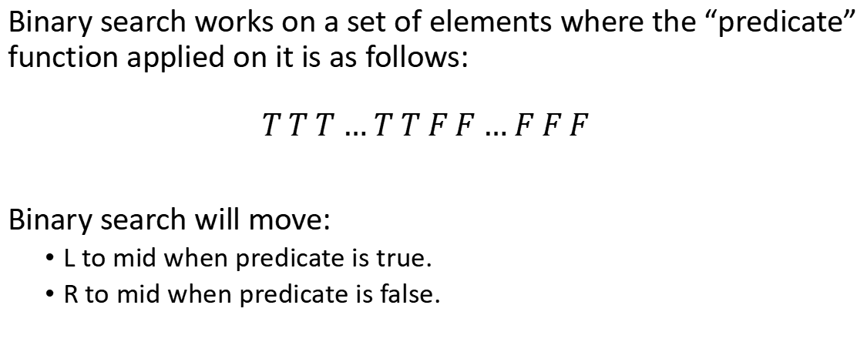
Binary Search Conditions
Binary search works on a set of elements where the “predicate” function applied on it is as follows:
$$T T T … T T F F … F F F$$
Binary search will move:
L to mid when predicate is true.
R to mid when predicate is false.

Slide 10
Alternative Binary Search
int l = min-1, r = max+1; while (r-l > 1) { int m = (l + r) / 2; if (predicate(m)) l = m; else r = m; } // l is the last true // r is the first false

Slide 11
Points to Note
When L = R-1, check if (L+R)/2 should be floored or ceiled. It might be an infinite loop otherwise.
Make sure your boundaries are correct.
You can use L + (R-L)/2 to avoid errors/overflows in some cases where L+R exceeds the integer limit.
If you ever need to run binary search on an infinite list, you can use LLONG_MAX or some other appropriate value as the upper-bound.

Slide 12
Problem Solving
https://cses.fi/problemset/task/1068
https://cses.fi/problemset/task/1083
https://cses.fi/problemset/task/1069
https://cses.fi/problemset/task/1094
https://cses.fi/problemset/task/1070
https://leetcode.com/problems/find-peak-element/

Slide 13
Thanks for Watching!
Feedback form: https://docs.google.com/forms/d/e/1FAIpQLScQEC2PyA4QmBdVFhbZ7_2h5x-vjeC9Lg-FXxMRXSyJMKsM2g/viewform

